Slide 1
Development of
Creative Cultural Industry
in Taipei
CCIII sec. E
Erin, Eva, Jessie & Yvonne

Slide 2
Outline
I. Introduction
A. Definition of “Creative Cultural Industry”
B. Motivation & Objectives
C. Research methods
II. Questionnaire
．Results & Analyses
III. Interviews
A. TheCan
B. ArtYard
C. Comparison & Contrast of The Can & ArtYard
IV. Conclusion

Slide 3
Introduction
． Definition of “Creative Cultural Industry”
．Motivation & Objectives
．Research methods

Slide 4
Definition of “Cultural and Creative Industries” (CCI)
According to “Law for the Development of the Cultural and Creative Industries” (文化創意產業發展法):
“The ‘Cultural and Creative Industries’ referred to in this
Act means the following industries that originate from
creativity or accumulation of culture which through the
formation and application of intellectual properties,
possess potential capacities to create wealth and job
opportunities, enhance the citizens’ capacity for arts, and
elevate the citizens’ living environment,”
Source: Ministry of Culture (http://www.moc.gov.tw/law.do?method=find&id=247)

Slide 5
Definition of “Cultural and Creative Industries” (CCI)
(cont’d)
cultural assets application & exhibition & performance facility industry
handicrafts industry
film industry
radio and television industry
broadcast industry
publication industry
advertisement industry
product design industry
visual communication design industry
designer fashion industry
architecture design industry
digital content industry
creativity living industry
popular music and cultural content industry
Other industries as designated by the central competent authority
Source: Ministry of Culture (http://www.moc.gov.tw/law.do?method=find&id=247)

Slide 6
Motivation & Objectives
Motivation
Interest in Taiwan’s culture
Passion for CCI
Objectives
Providing first-hand Information and analyses
on current CCI development
Encouraging young people to join CCI
for preserving and Inheriting Taiwan’s culture

Slide 7
Research Methods
Questionnaire:
To reveal
young people’s
lack of knowledge
of CCI
Interviews:
To present
CCI current development,
including difficulties,
solutions, and vision
Objectives
To provide sufficient information and in-sight of CCI
To encourage participation of CCI

Slide 8
Questionnaire:
Results & Analyses
Research method (I)

Slide 9
Questionnaire
Respondents: college students in Taiwan
Samples: 138, randomly
Hypothesis: College students do not know about CCI very well
Contents:
The understanding of CCI
The participation in CCI
Evaluation towards Taipei CCI's prospect
Purpose:
To test how much do college students know about CCI
To find out the problems of CCI development in Taipei by analysing the results of questionnaire
Results: College students do not know about CCI very well and few of them know about The Can and ArtYard.

Slide 10
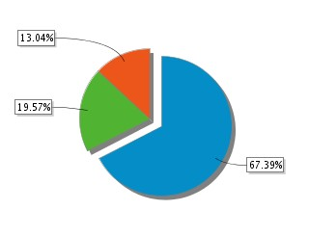
Analysis
Fuzzy definition about CCI
Do you know what CCI is?
Not very well
Yes
No

Slide 11
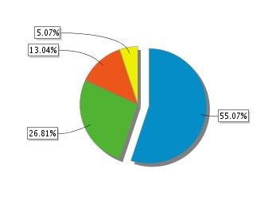
Analysis
Wide acceptance for creative jobs
The popular jobs nowadays
Designing and creative jobs
Economic jobs
Jobs with language skills
Engineering jobs

Slide 12
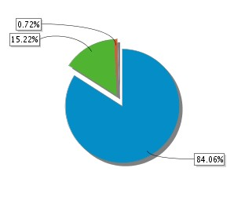
Analysis
Low participation in CCI activities
How many places do you know about CCI?
0-5
6-10
More than 10

Slide 13
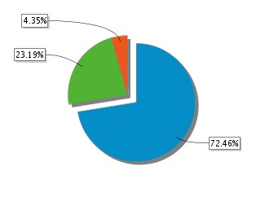
Analysis
Low participation in CCI activities
Once a season
Once a month
Once a week
The frequency of going to CCI activities

Slide 14
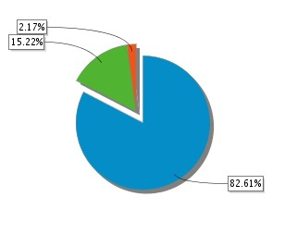
Analysis
Evaluation towards Taipei CCI's prospect
Optimistic attitude towards CCI
Do you think CCI has promising prospect?
Yes
Not so sure
No

Slide 15
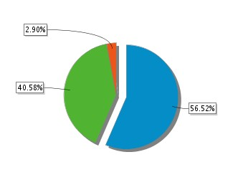
Analysis
Evaluation towards Taipei CCI's prospect
Optimistic attitude towards CCI
Yes
It depends
No
The willingness of working for CCI if possible

Slide 16
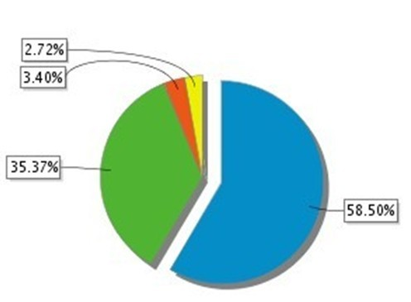
Reasons for interviewing The Can & ArtYard
We need first-hand information about CCI
Many college students have been to Four Four South Village& Good Cho's but few have been to The Can & ArtYard
The Can & ArtYard are avaliable for interview
None
Four Four South Village & Good Cho's
The Can
ArtYard
Have you been to The Can & ArtYard?

Slide 17
Interviews of CCI in Taipei
The Can
&
ArtYard
Research method (II)

Slide 18
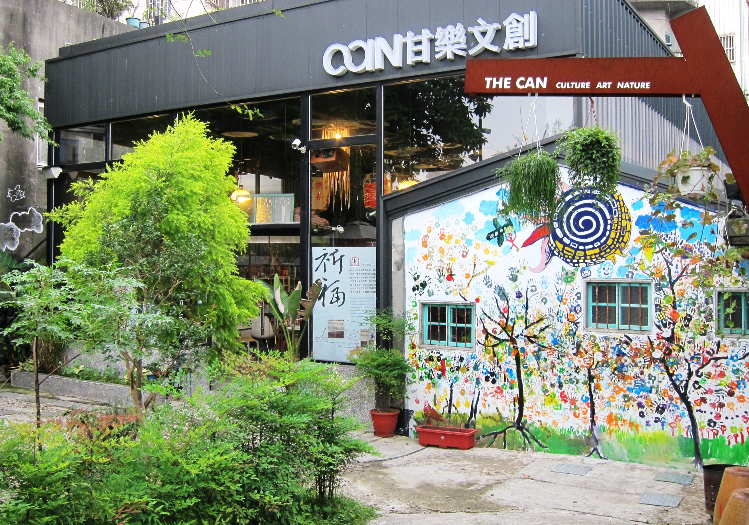
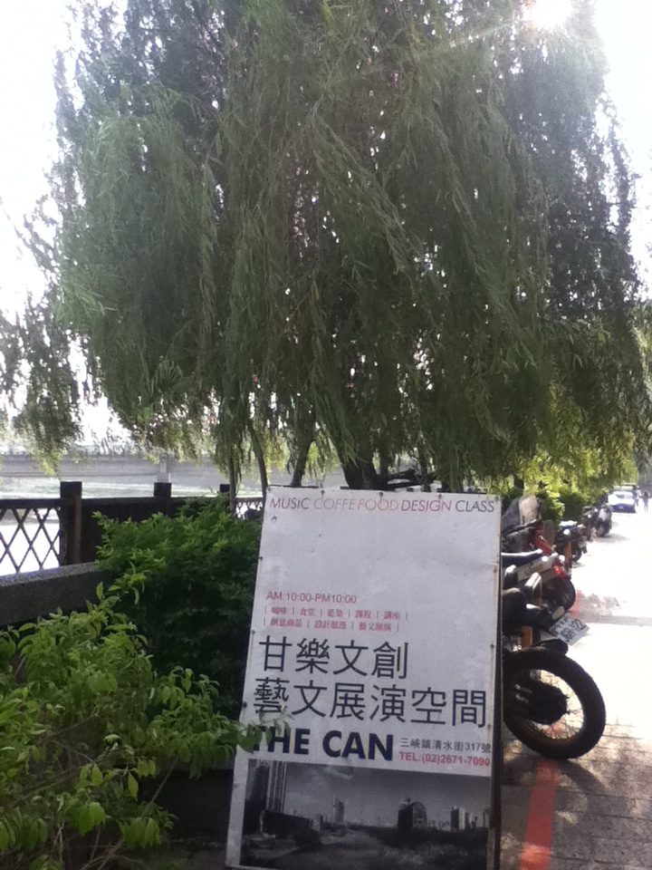
The Can in Sanhsia

Slide 19
Historical Background of Sanhsia
The Forming of Sanhsia Town and Flourish Business During Qing Qianlong
Late Ming Dynasty
  Immigrants from Mainland China
  Along Sanhsia river→ mountain areas
  Tea plantation and daqing (大菁)
Qing Dynasty
  As a distributing center
  Three main industries: Boiling camphor(樟腦)
  Cloth Dyeing
  Tea Making

Slide 20
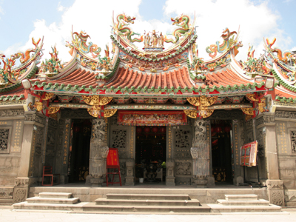
Historical Background of Sanhsia
Japanese colonization and the restoration of Taiwan
Under Japan’s rule
  Actively constructing with the special architectural style
  Mining and lumbering
After the restoration of Taiwan
  Zushi Temple
  Professor Li Mei-Shu
  Religious and artistic

Slide 21
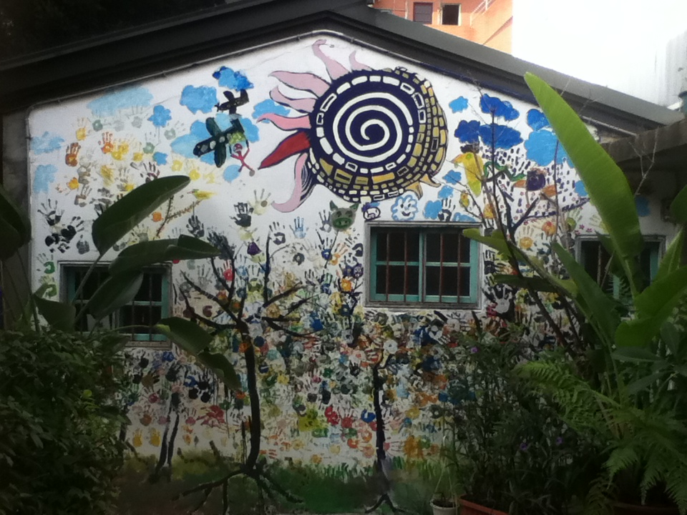
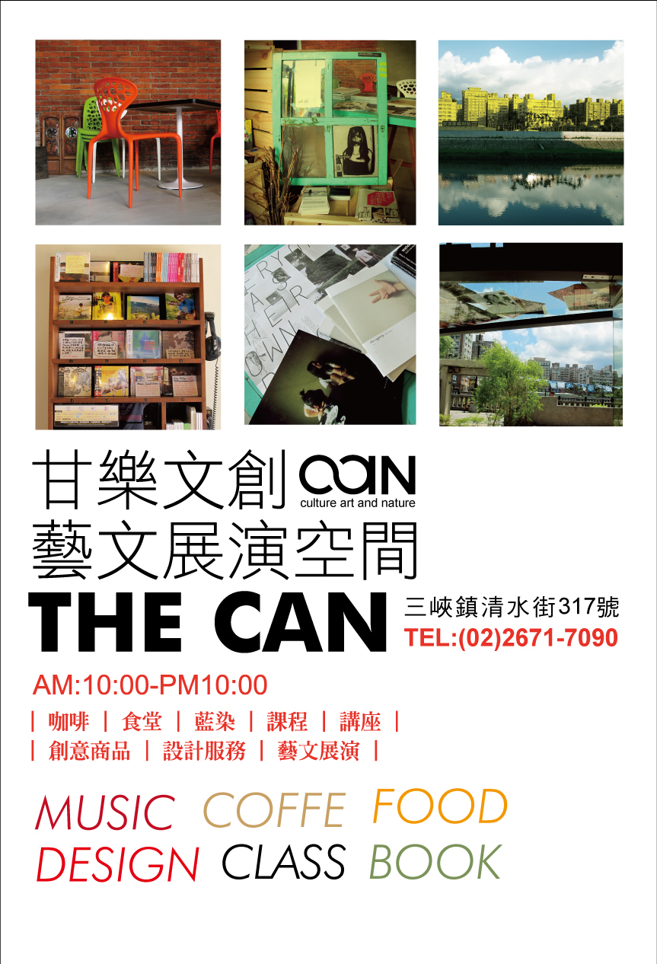
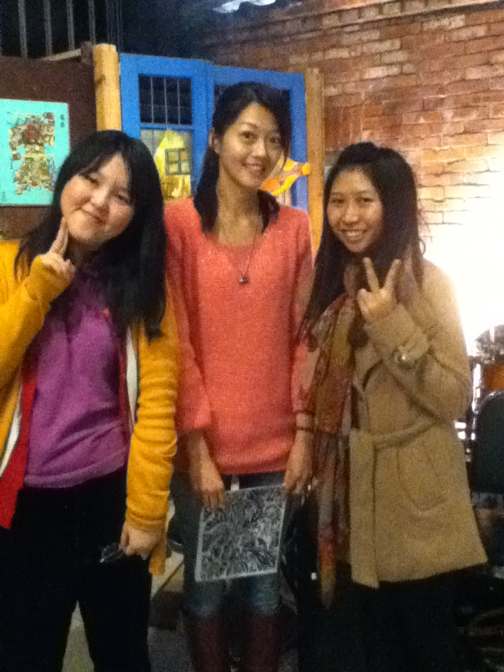
The Can

Slide 22

What is 甘樂?
Chinese proverb“甘之如飴，樂在其中”
Similar to the spinning top in Taiwanese
THE CAN :「c」+「a」= ∞
I can do it. You can do it. We can do it!

Slide 23
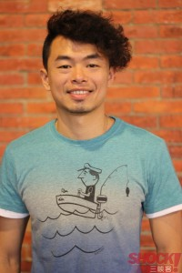
Introduction of The Can
Founder: Mr. Jeffrey Lin (林峻丞)
locally born in Sanhsia in 1982
許效舜’s apprentice
The TV program producer of “Fun Taiwan”
Back to help the family-run old soap factory →Cha Shan Fang(茶山房)
Commercialized old street
Established The Can in 2010

Slide 24

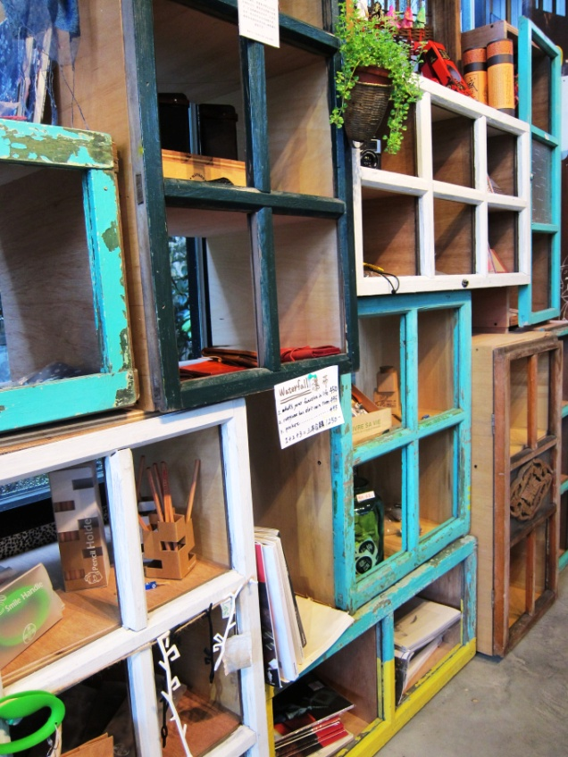
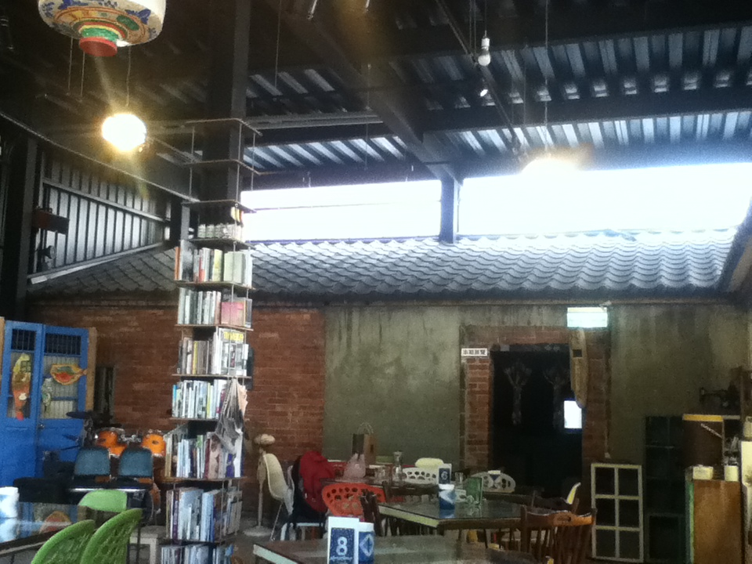
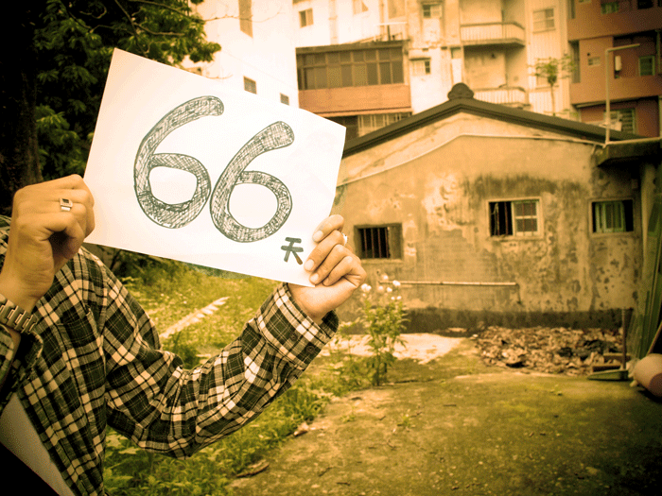
Introduction of The Can
Founder: Mr. Jeffrey Lin (林峻丞)
The last san-ho-yuan(三合院) on Qingshui St.
new construction over 100-year-old house

Slide 25
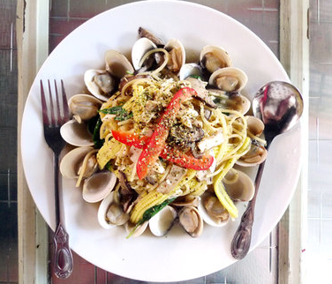
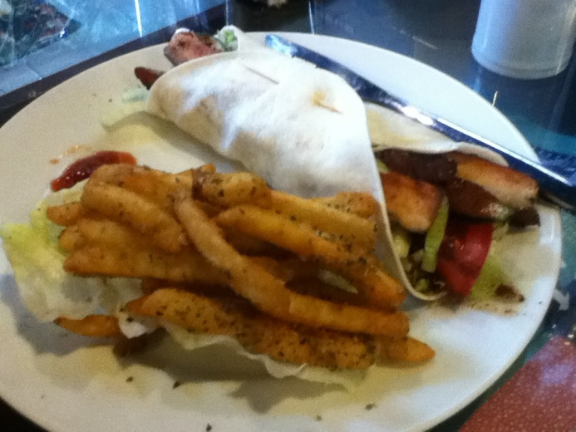
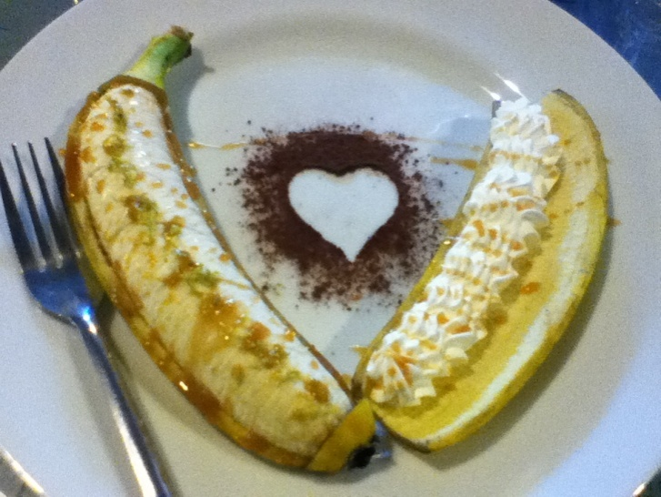
What does The Can do?
Café & Restaurant
  Pasta, risotto, drinks, homemade cookies

Slide 26
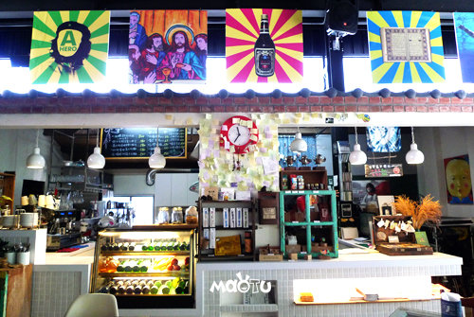
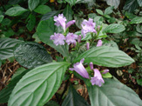
What does The Can do?
Café
  Daqing
  into
  cuisine

Slide 27
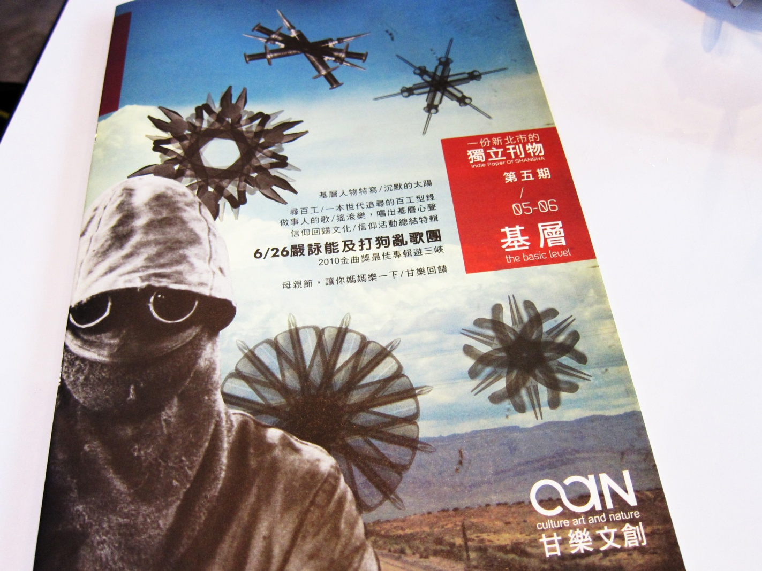
What does The Can do?
What does The Can do?
The Can magazine
  ．Published independently
  ．Every two months
  ．4000 issues for free
  ．online version
  ．Care for the local small fry (在地小人物), the environment and social issues
27

Slide 28
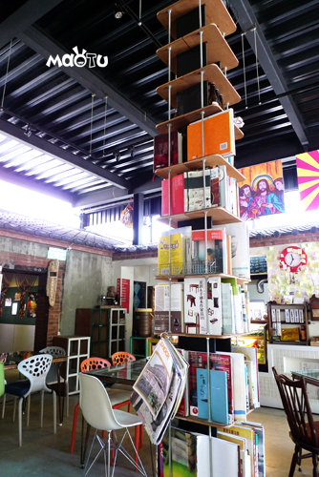
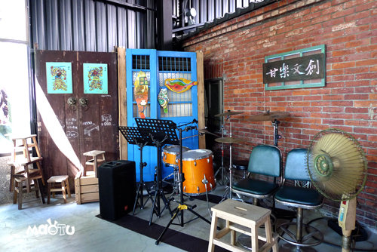
What does The Can do?
What does The Can do?
Exhibition platform
Live band performance
Space rental
Designing service

Slide 29
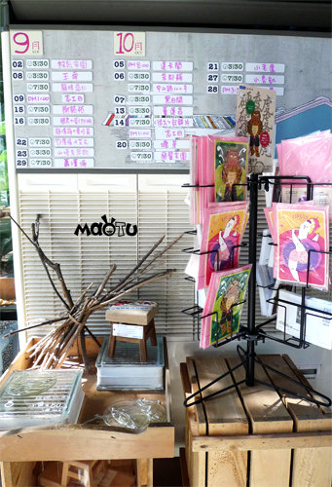
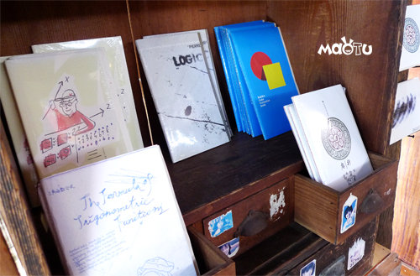
What does The Can do?
What does The Can do?
Selling creative products, postcards, notebooks, CDs (Taiwan’s independent music)….etc

Slide 30
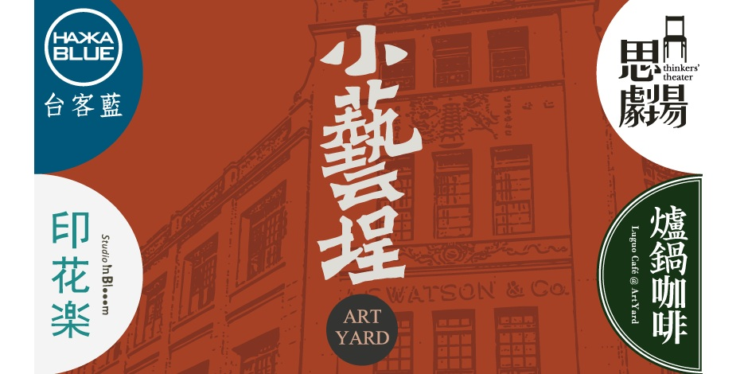

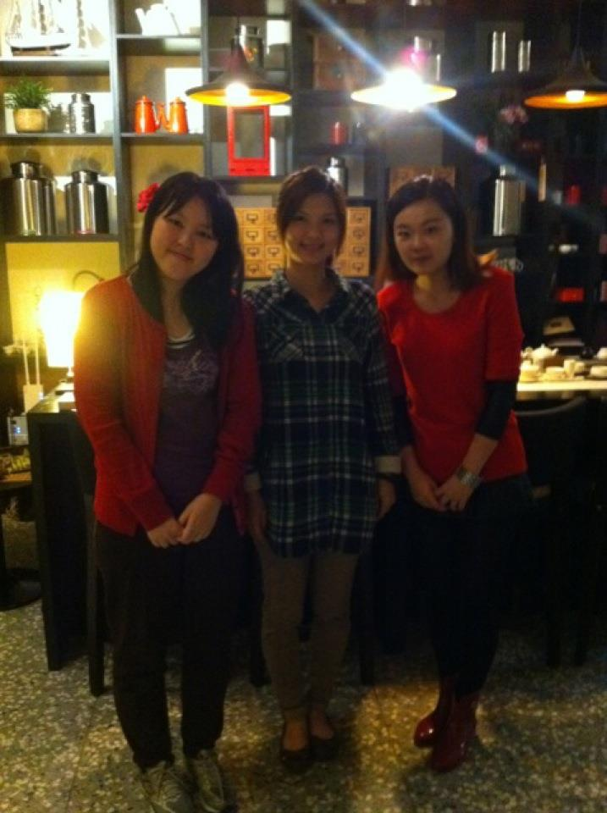


ArtYard in Dadaocheng
The meaning of “art” selling in Dadaocheng

Slide 31
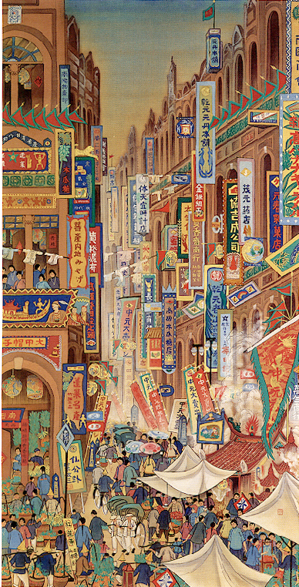
Historical Background
Dadaocheng
Trading port
The center of textile industry
Where the 228 Incident happened
Politically, culturally and historically meaningful
31

Slide 32
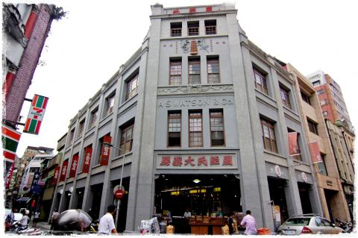
The A.S. Watson & Co building
(屈臣氏大藥房)
Landmark in Dadaocheng
The first western medicine pharmacy
32

Slide 33
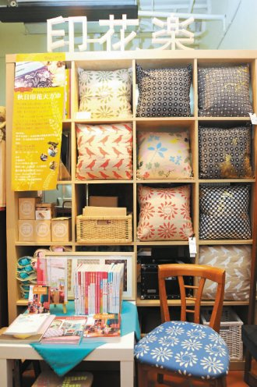
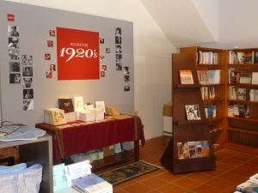
ArtYard（小藝埕）
↑Bookstore 1920s (1F)
↑In Blooom (印花樂) (1F)
33

Slide 34
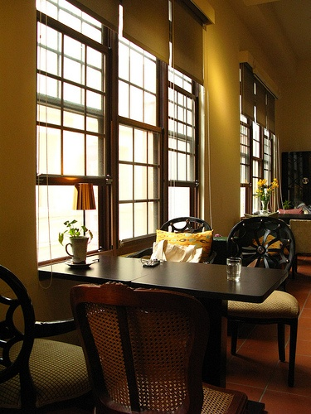
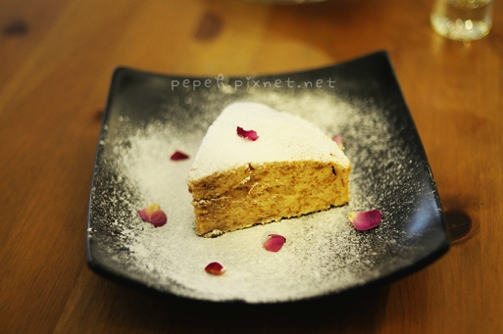
ArtYard（小藝埕）
Taiwan-made coffee
cake with roseleaves
↑Luguo Cafe (爐鍋咖啡) (2F)
dried food

Slide 35
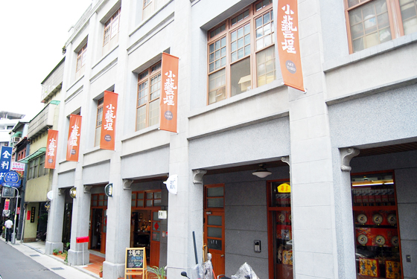
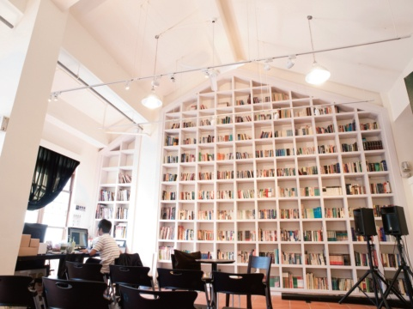
ArtYard (小藝埕)
Subjects: history, philosophy, arts
(Exhibitions, performances, speeches, talks, readings)
↑Thinkers Theater (思劇場) (3F)

Slide 36
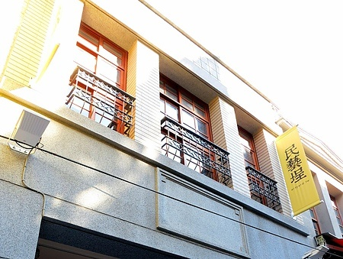
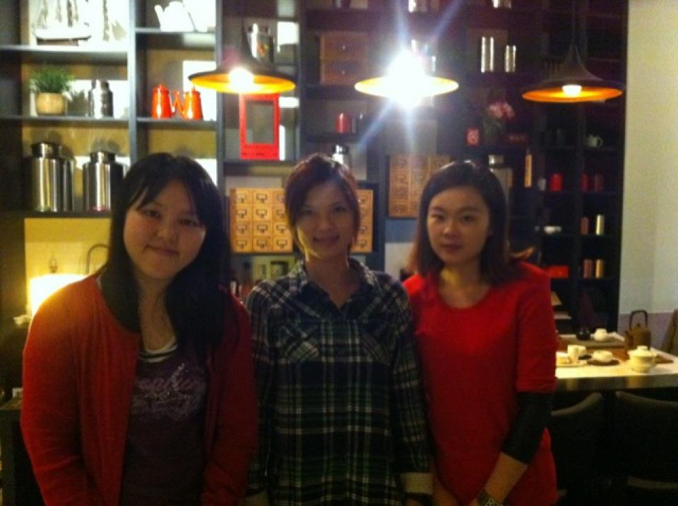
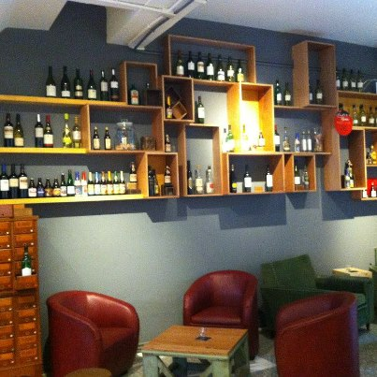
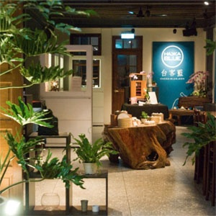
ArtYard（民藝埕）
ceramics studio
↓Hakka Blue (台客藍) (1F)
↑South St. Delight (南街得意)(2F)
↑洛 Le Zinc(1F)
36

Slide 37
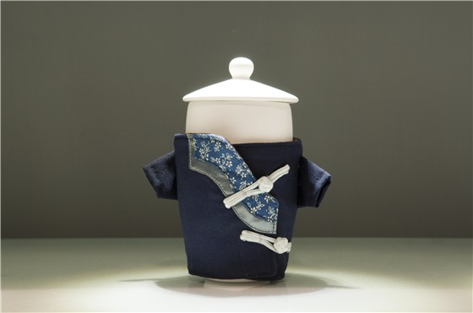

What is Hakka-Blue ?
Hakka-Blue (台客藍)?
“台” — “Native” (本土)
“客” — “Humanity” (人文)
“藍” — “Fashion” (時尚)
Founded by
Jou Yi-cheng (周奕成) &
the ceramicist Xiao Li-ying （蕭立應）

Slide 38
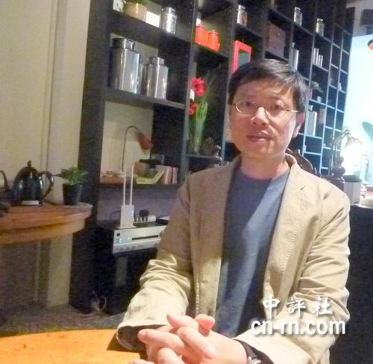
Jou Yi-cheng (周奕成)
CEO of ArtYard
38
Co-managed by the Sedai Group (世代群)
Founded by Jou Yi-cheng (周奕成)
Former political activist
“Public space”
“Art renaissance”
“New cultural movement”

Slide 39
Comparison & Contrast b/t
The Can & ArtYard
3/14/2013

Slide 40
Comparison & Contrast b/t
The Can & ArtYard
 | The Can | ArtYard
Organizer | Mr. Jeffrey Lin Was born and raised in San-Hsia | Jou Yi-cheng Resident of the Mensheng community
Established | In September, 2010 | In 2011
Target Audience | Customers of all ages
 | Visitors mostly on weekends residents mostly on weekdays
3/14/2013

Slide 41
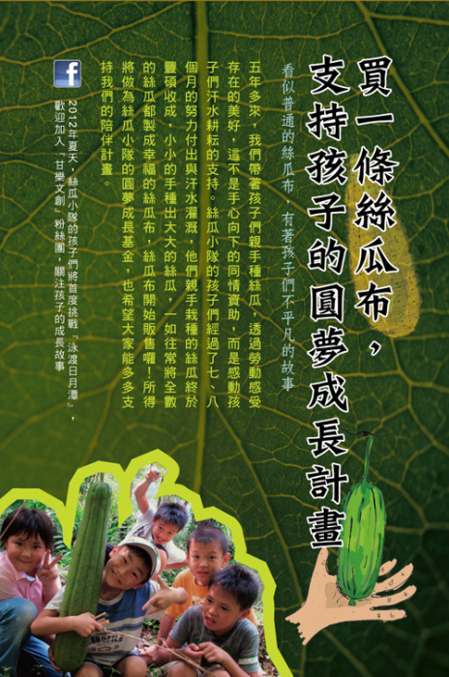
Comparsion and Contrast b/t
The Can & ArtYard
 | The Can | ArtYard
Dining | Café & restaurant | Café, tea House, bar
Self-branded product | No | Yes, postcards of 1920’s bookstore
Core Value | Loofah team 絲瓜小隊 -underprivileged students of Youmu -loofahs, bath sponge - Funds for dreams -long-term accompany project | -Care for people -Making friends -Feels like home -Sense of happiness
 | People-oriented, not profit-oriented
3/14/2013

Slide 42
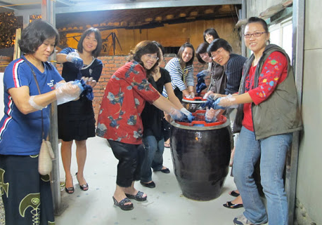
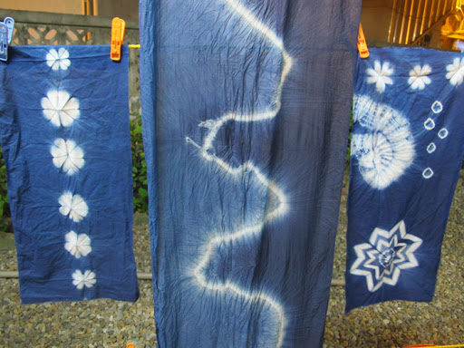
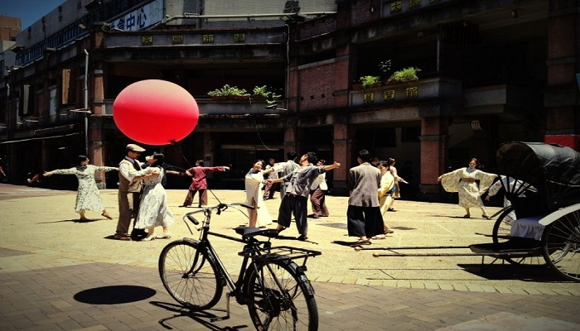
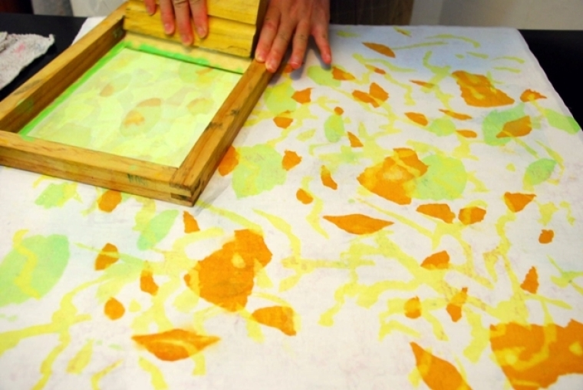
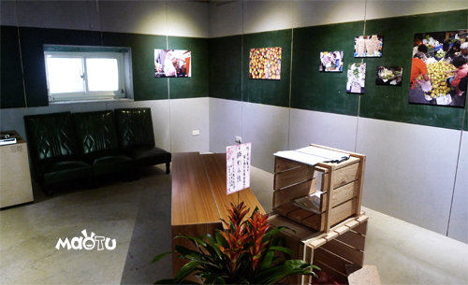
Comparison and Contrast b/t
The Can & ArtYard
 | The Can | ArtYard
Hands-on experience | Blue-dyeing workshop | Fabric workshop
Artistic platform | Gallery, live band | Gallery, lecture
Feature | Has more to do with the people and the community (cleaning Sanhsia river) | Related to its historical background 1920s parade
3/14/2013

Slide 43
Comparison and Contrast b/t
The Can & ArtYard
 | The Can | ArtYard
Difficulty | Lack of capital Lack of popularity Lack of community resources Lack of recognition from the local residence | Lack of human resource (How to get more talented people to join ArtYard)
Neighboring relation | Having hard time to integrating with neighboring shops | Close relationship
Vision | The integrated village | The great ArtYard
3/14/2013

Slide 44
Conclusion
Possible solutions for
current CCI difficulties
Encouraging young people
to participate in CCI
2013/3/14

Slide 45
The Possible Solutions
Financial difficulties: funding for publicity
Solution A – Corporation with mass media
Solution B – Corporation with local community
Lack of human resources: require for talents
Solution A – Internship for students
Solution B – Welcome people from any generation

Slide 46
Encouragement to young generation
Suggestions from the Interviewee of The Can
．Endurance
．Devotion
Suggestions from the Interviewee of ArtYard
．Passion
．Social experiences

Slide 47
Works Cited
Shu, Catherine . “Tending the cultural landscape.” Taipei Times. 18 Aug. 2011. Web. 29 Nov. 2012. <http://www.taipeitimes.com/News/feat/archives/2011/08/18/2003511004 >.
“Afternoon Time, Art Yard.” International Spotlight Northern Region. 1 Sep. 2012. Web. 29 Nov. 2012. <http://eng.tteacafe.tw/?p=996>.
“Culture Street’s ‘Little Art Jar’ – 1920’s exhibition.” PeoPo Weekly Review. 19 Nov. 2012. Web. 2 Dec. 2012. < http://www.peopo.org/weeklyreview/post/110891>.
“Youngsters Get Second Chance in Sun Moon Lake Swim.” Taipei Times. 11 Jul. 2012. Web. 25 Nov. 2012. <http://www.taipeitimes.com/News/taiwan/archives/2012/07/11/2003537483 >.
Crook, Steven. “Sanhsia -- The three gorges of Taipei County.” Taipei Times. 6 Apr. 2001. Web. 25 Nov. 2012. <http://www.taipeitimes.com/News/feat/archives/2001/04/06/0000080612/2 >.
“About Sanjiaoyong.” Sansia Old Street. N.d. Web. 25 Oct. 2012. <http://www.sanchiaoyung.com
.tw/about?Lang=en>.
“The Story about Love and Loofahs.” The Can. N.d. Web. 4 Oct. 2012. <http://blog.roodo.com/the
can/archives/18577977.html>.

Slide 48
Thanks for listening

